Slide 1



TEAM NAME- PROJECT SAMARTH KRUSHAK
COLLEGE NAME- VEER SURENDRA SAI UNIVERSITY OF TECHNOLOGY
© 2024 Cognizant

Slide 2

Team Information Template
Team Name | Team Member Name | Mail ID | Department | Year of passing
PROJECT SAMARTH KRUSHAK | SUVENDU SEKHAR DAS | suvendusekhardas16@gmail.com | ELECTRICAL AND ELECTRONICS ENGINEERING | 2025
 | ISHA PRIYADARSHANI BISWAL | ishabiswal66@gmail.com | ELECTRICAL AND ELECTRONICS ENGINEERING | 2025
 | SULEKHA BISWAL | sulekhabiswal2013rta@gmail.com | COMPUTER SCIENCEE AND ENGINEERING | 2025
 | ASMI AGRAWAL | asmiagrawal09@gmail.com | COMPUTER SCIENCEE AND ENGINEERING | 2025
© 2024 Cognizant

Slide 3
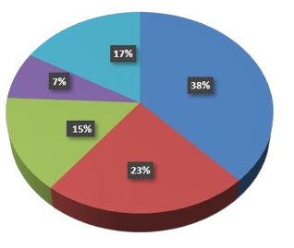
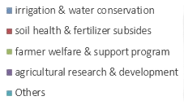

Idea/Problem Statement Summary
India's agricultural sector, which employs over 50% of the workforce and contributes 15% to the GDP, is facing a crisis marked by water scarcity, soil degradation, and inefficient traditional farming practices, resulting in significant food security and sustainability challenges. The sector's growth has declined sharply to 1.4% in FY24, exacerbated by severe water wastage, accelerated soil erosion, and low rural incomes, disproportionately affecting farmers who lack resources and knowledge to adopt sustainable practices.
Our solution Project Samarth Krushak will combat the above problem by the following practices:-
Utilize advanced drones and IoT sensors to collect and analyze real-time field data, offering a more precise and efficient approach to resource management and reducing water wastage compared to traditional methods.
Utilize AI algorithms for pest detection, disease diagnosis, and nutrient analysis to improve crop health and yield.
Facilitate data storage, analysis, and visualization for actionable insights, while ensuring the platform is user-friendly for farmers with varying technical backgrounds.
Budget Allocation(agriculture sector)-Rs. 1,32,000 crores
© 2024 Cognizant

Slide 4
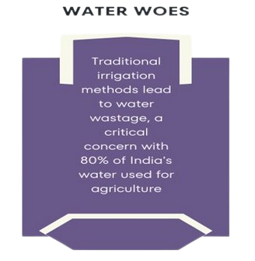
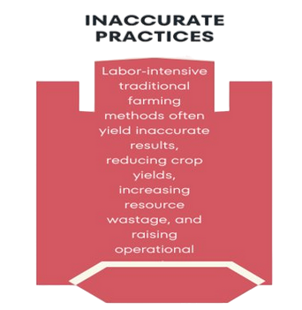
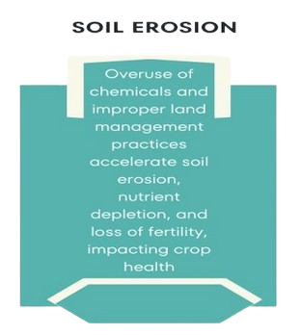
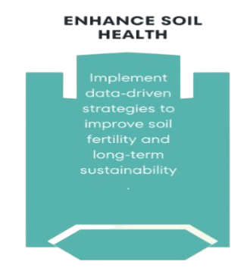
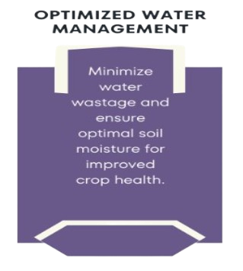
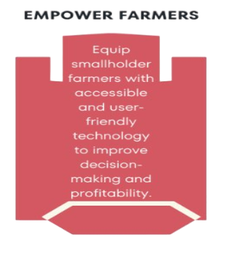
From Challenges to Solutions
Major Challenges
Our
Solution
© 2024 Cognizant

Slide 5
Use Cases
Early Pest Detection and Management
Automated Soil Health Monitoring
Smart Water Management for Irrigation
A farmer notices initial signs of crop damage but is unsure of the cause.
Using Smart Krushak's AI-powered image recognition, the farmer takes photos, and the system identifies the pest and suggests treatments.
Early detection allows prompt action, preventing widespread damage and crop loss.
Farmer lacks soil health information.
Smart Krushak's IoT sensors measure soil pH, nutrients, moisture.
AI gives real-time soil improvement tips, boosting crop health and yields.
Farmer in a water-scarce area needs efficient water use.
Smart Krushak uses IoT sensors to monitor water levels and weather.
Automated irrigation based on real-time data saves water, cuts costs, and supports sustainability.
© 2024 Cognizant

Slide 6
High Level Architecture
© 2024 Cognizant

Slide 7
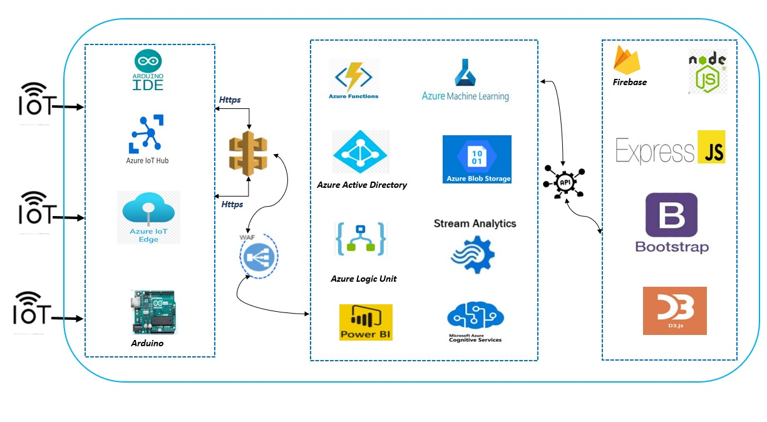
© 2024 Cognizant

Slide 8
Technology Stack
Technology/Tool | Function | Justification for Choice | Significance
IoT Sensors | Collect soil data (moisture, pH, temperature, nutrients) | High accuracy, real-time data collection | provides critical data for analysis
Drones | Aerial field data collection and monitoring | Efficient large-area coverage, precise data collection | enhances data collection efficiency
Microcontroller (e.g., Arduino) | Interface with sensors, process data | Flexible, widely used, robust community support | core component for sensor data processing
GPS Module | Location tagging of soil samples | Accurate geolocation data | ensures data is geographically contextualized
Azure IoT Hub | Manage IoT devices, ingest data | Scalable, secure, integrates well with Azure cloud services | central hub for managing and processing IoT data
Azure Functions | Serverless computing for data processing | Scalability, cost-efficiency, integrates with other Azure services | processes data using AI models
Azure Machine Learning | Develop, train, and deploy AI models | Robust machine learning lifecycle management | powers AI algorithms for analysis
© 2024 Cognizant

Slide 9
Technology/Tool | Function | Justification for Choice | Significance
Azure Cosmos DB | Store IoT sensor data | Globally distributed, highly available NoSQL database | stores large volumes of real-time data
Azure Time Series Insights | Analyze time-series data for trends | Native time-series data storage and analysis | provides insights into temporal data patterns
Azure Web App | Host the user interface (dashboard) | Easy deployment, scalable, integrates with Azure services | user-friendly access to insights
Firebase (for Mobile App) | Real-time database, user authentication | Real-time capabilities, ease of use | mobile accessibility for farmers
React.js, Node.js, Express.js, Bootstrap, D3.js | Frontend and backend frameworks for building user interfaces, responsive design, data visualization | Component-based architecture, efficient rendering, event-driven, non-blocking I/O model, simplifies server-side development, powerful visualization capabilities | dynamic, responsive web application, supports real-time data processing and API creation, ensures mobile-friendly user interface, advanced data representation
© 2024 Cognizant

Slide 10
Low Level Architecture
© 2024 Cognizant

Slide 11
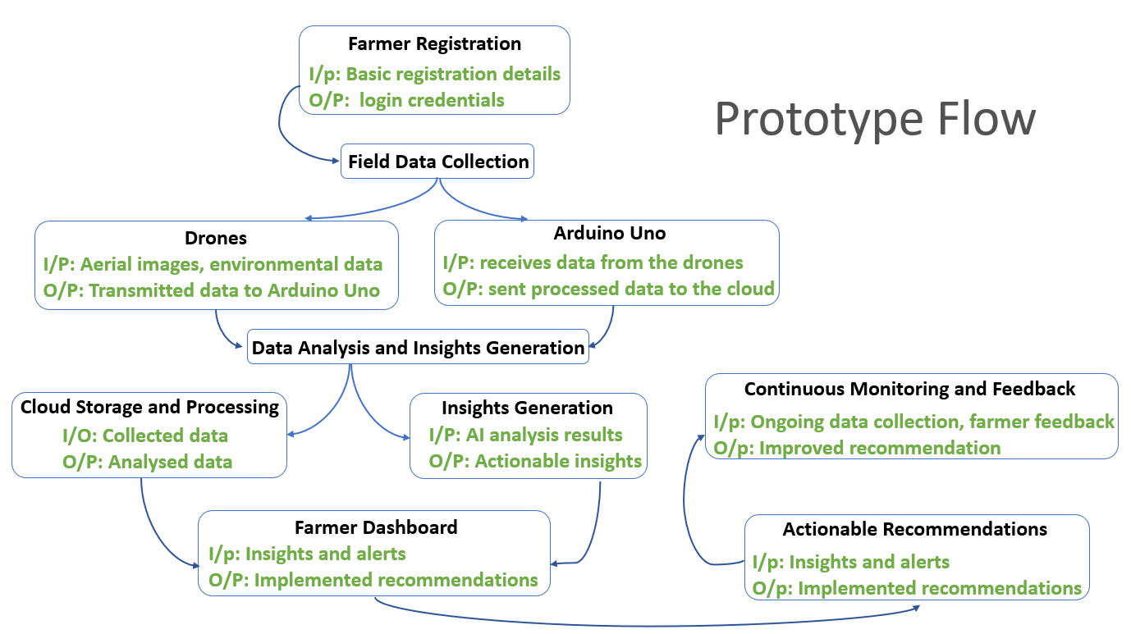
© 2024 Cognizant

Slide 12
MVP Implementation
© 2024 Cognizant

Slide 13
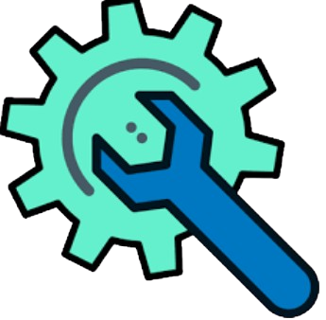
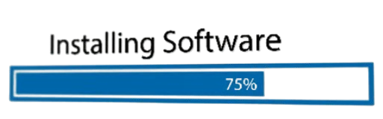


Steps for MVP Implementation
Step-1:Hardware Setup-We assembled our Arduino with different components and connected them.
Step-2:Software Setup-We wrote and uploaded Arduino code, set up Firebase project, configured Firebase library in Arduino IDE.
Step-3:Integration-We connect Arduino to Wi-Fi, ensure seamless Firebase communication, and configure read/write access rules.
Step-4:Testing-We test movement, planting, obstacle detection, and verify Arduino-Firebase data transmission.
© 2024 Cognizant

Slide 14
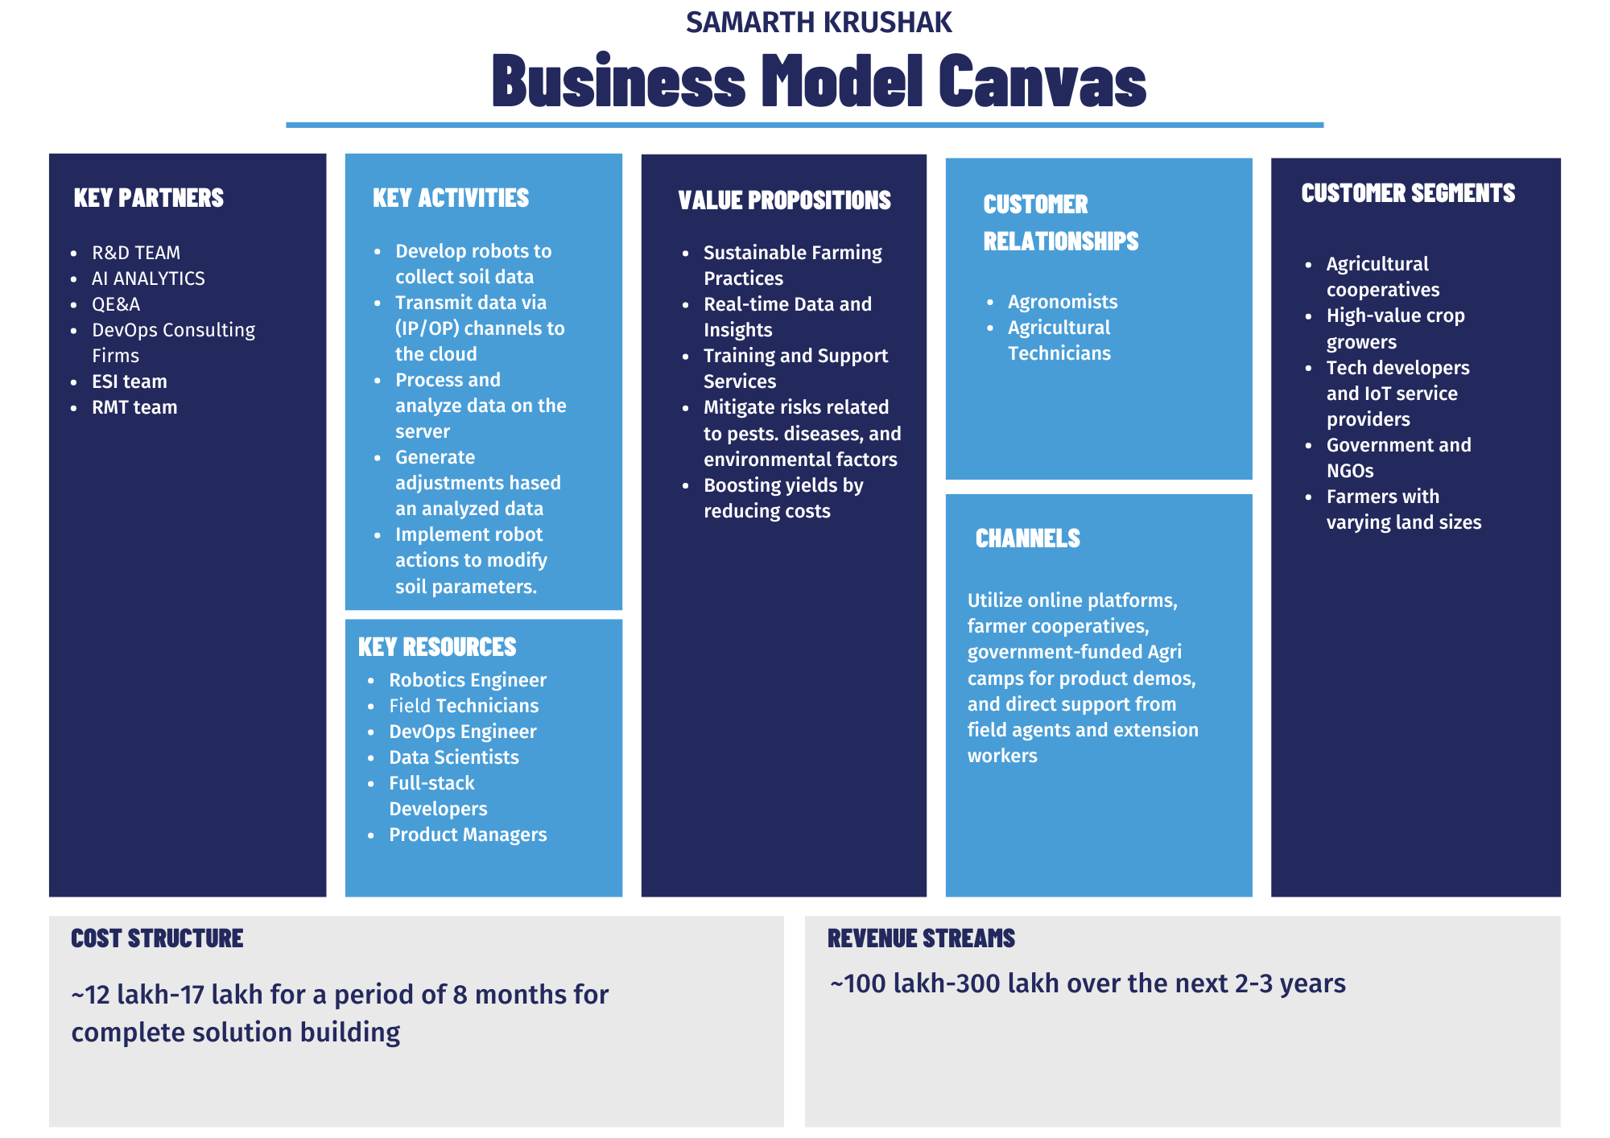
© 2024 Cognizant

Slide 15
LINK TO VIDEO AND SOURCE CODE FOR MVP
https://drive.google.com/drive/folders/1jimwfprWBAM6EFuyawFiVNT9G6lIlfzQ?usp=sharing
© 2024 Cognizant

Slide 16
Future Possibility: Soil Moisture Measurement Integration
1.Sensor Integration:
Soil moisture sensor can be added to the robot to measure soil moisture content accurately.
2.Data Logging:
Firebase or any other server can be used to log the soil moisture data in real-time.
3.Database Comparison:
Cloud database can be used to store optimal soil moisture values and compare them against the measured data.
4.Action Based on Data:
Web/Mobile app can inform the farmer if the moisture levels are below or above optimal.
Automated watering or lime spraying system can be implemented to adjust soil conditions directly from the robot.
5.Enhanced Automation:
Continuous monitoring and adjustment of soil conditions can be achieved using real-time data from sensors and automated responses to maintain optimal growth conditions.
© 2024 Cognizant

Slide 17
THANK YOU
© 2024 Cognizant

